Slide 1
Hardware Software Platforms Project Presentation
DE1-SoC : Servomotor control
Fattahi Idriss and Honorez Valentin:
Idriss.FATTAHI@student.umons.ac.be
Valentin.HONOREZ@student.umons.ac.be

Slide 2
Introduction and Motivations
MAIN GOAL ➔ Control a servomotor with the DE1-Soc board with known solutions.
Objectives of the project :
Doing technical researches.
Improve VHDL skills.
Implement existing works.
Develop a driver and its test bench.
Develop an application and its test bench.

Slide 3
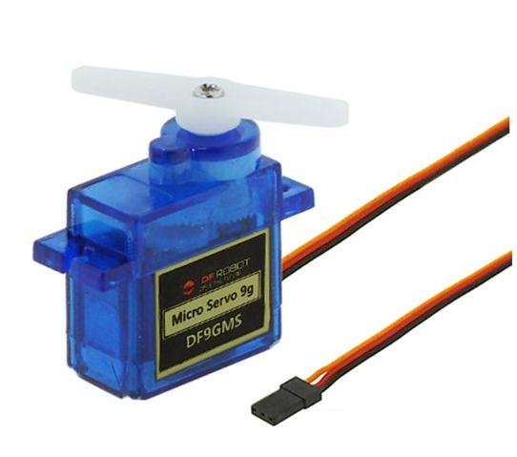
Theoretical background : Servomotor
Motorized system to reach predetermined positions.
Composed of:
A motor.
Gears.
Electronics components.
Controlled by a PWM signal.

Slide 4
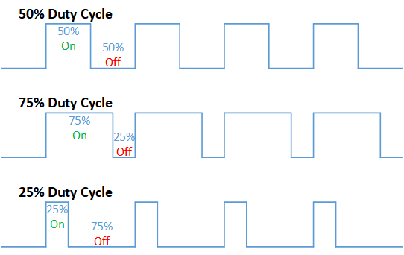
Theoretical background : PWM signal
Binary signal.
Mean signal is an analogue signal.
Fixed period.
Duty cycle.

Slide 5
Software to install
https://fpgasoftware.intel.com/?edition=lite
Quartus II
Intel account creation
18.1 Lite edition
CycloneV qdz file
Launch the Device installer from Quartus II
ModelSim

Slide 6
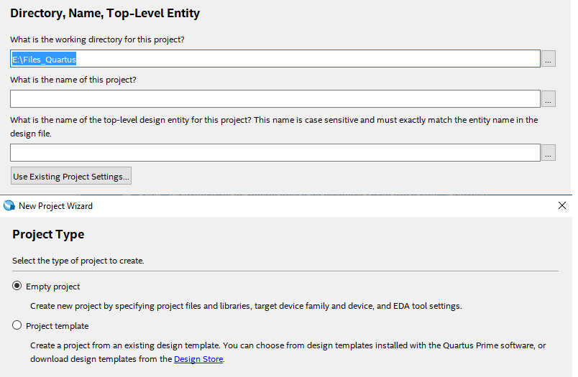
Project Creation
Launch Quartus II.
"New Project Wizard...“.
On the new window displayed:
Select the folder
Write the title of the project.
Click on “Next”.
Click on “Empty project” and on “Next”.

Slide 7
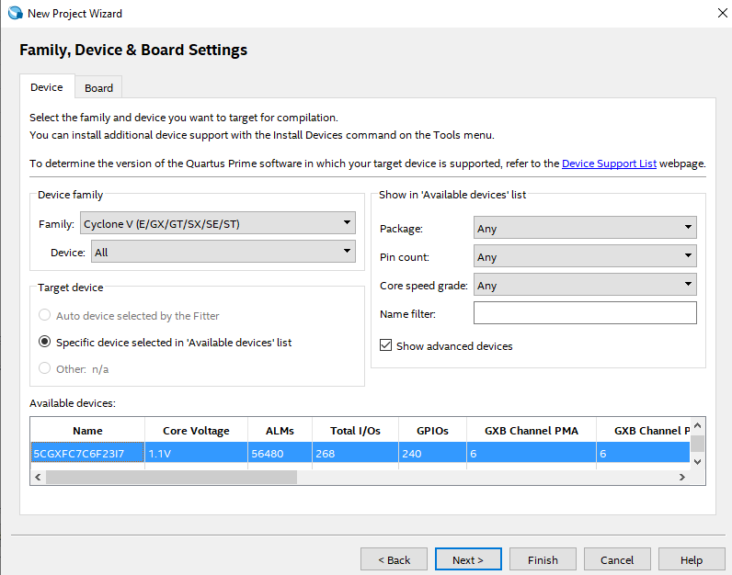
Project Creation
Click "Next" on the "Add files" window.
On the "Family, Device and Board Settings" window:
Select the family of component.
“Next”.
Here it is a Cyclone V5CGXFC7C6F23I7.

Slide 8
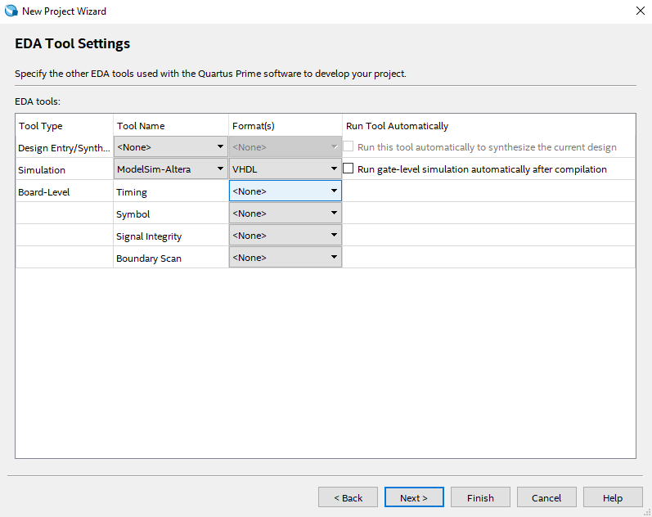
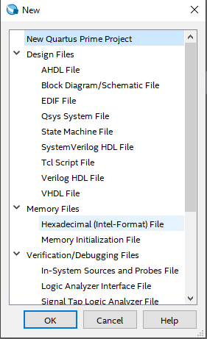
Project Creation
On the "EDA Tool Settings“:
"ModelSim-Altera“.
"VHDL".
Create a new file:
Select "New“.
Select "File“.
Select "VHDL File“.
➔ Add existing files = Method explained before.

Slide 9
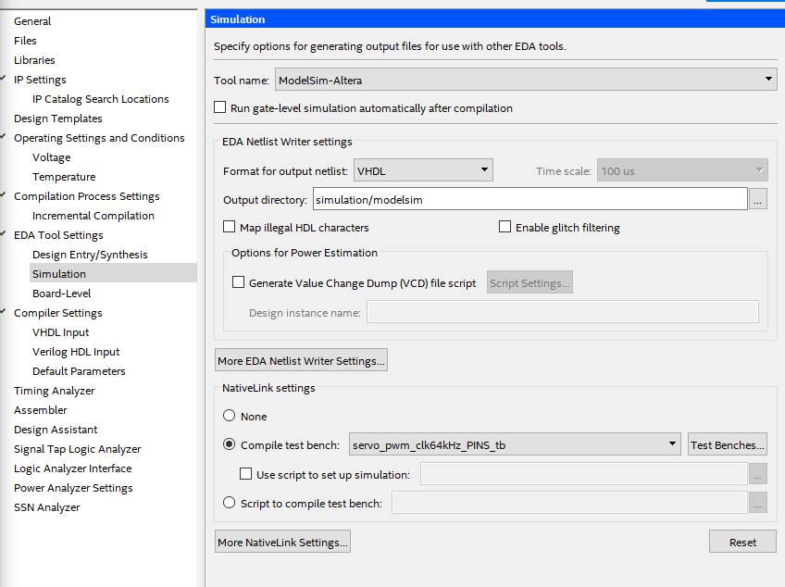
How to simulate
Main code ➔ top-level entity
Test bench file ➔ properties ➔ "VHDL Test Bench File".
Click on Assignments ➔ EDA Tool Settings ➔ Simulation:
Output directory = Modelsim directory.
Create a new Test bench.
Test bench name/File name = VHDL file.
Click on add.

Slide 10
How to simulate
Click on Processing and start the compilation.
Click on Tools, Run Simulation Tool, RTL simulation.

Slide 11
VHDL CODE
Divided in two parts :
PWM signal generation
Interface

Slide 12
PWM signal generation
Period : 20 ms
Minimum pulse width : 0.5 ms (0 degrees)
Maximum pulse width : 2.5 ms (360 degrees)

Slide 13
PWM signal generation
Altera Board clock : 100 MHz
We need a 64 kHz clock -> frequency divider
Why 64 kHz?

Slide 14
PWM signal generation
Range of operation : 2 ms
Number of positions token by the servomotor : 128
→ 128/2ms = 64 kHz

Slide 15
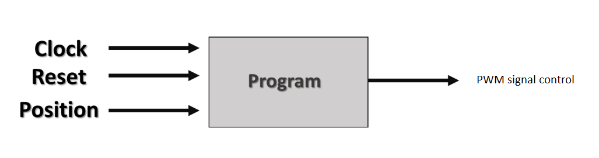
PWM signal generation
How to control the servo with the PWM ?

Slide 16
PWM signal generation
Clock : 64 kHz
Position : 7 bits (128 positions)
Definition of a 10 bits counter (count till 1279 in order to browse the signal period (1280 samples per period).)
Definition of the pwmi signal : unsigned( ‘0’ + pos ) + 32
Servo signal == ‘1’ when count<pwmi else ‘0’

Slide 17
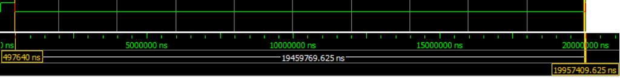
PWM signal generation
Pos ‘0000000’ (which correspond to 0 degrees)
Pulse width : 0.5 ms
Total period : 20 ms

Slide 18
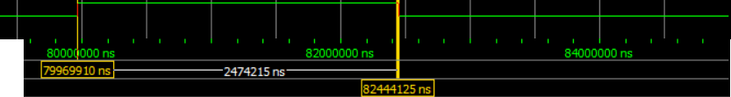
PWM signal generation
Pos ‘1111111’ which correspond to 1 turn (360 degrees)
- Pulse width : 2.5 ms

Slide 19
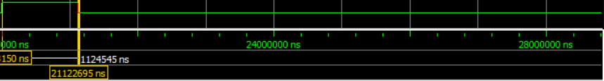
PWM signal generation
Position ‘0101000’ which corresponds to 112.5 degrees
- Pulse width : 1.10 ms

Slide 20
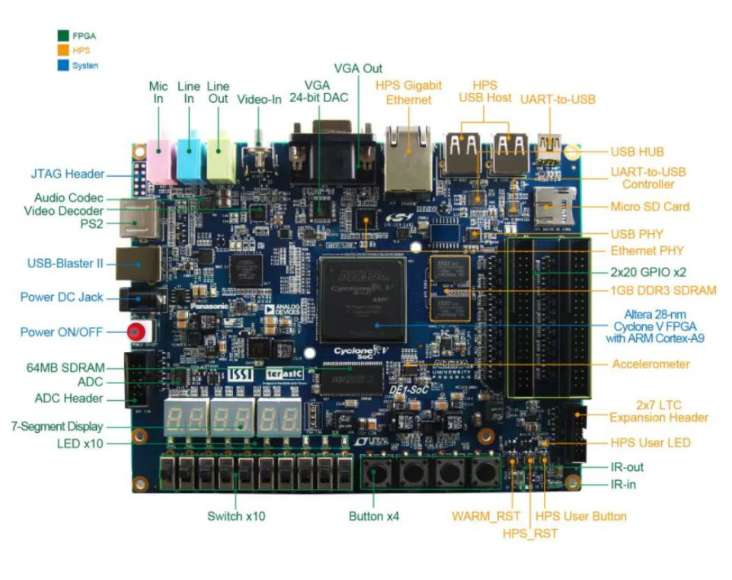
Interface
Altera Board DE1 - SOC

Slide 21
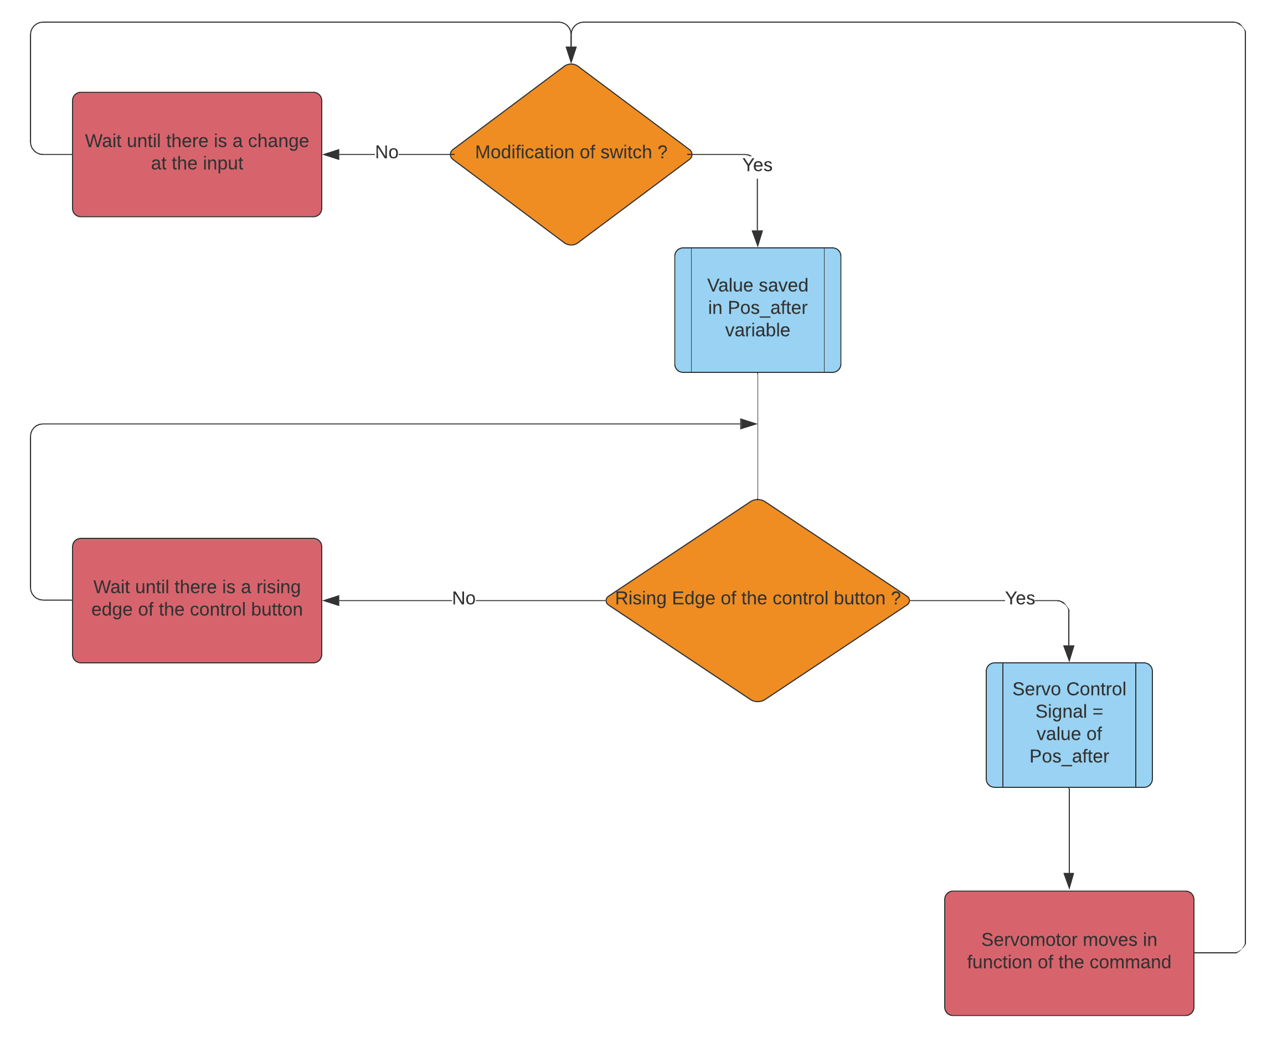
Interface: Diagram block of the behaviour of our program.

